Slide 1
Stroke Predictive Model
Leveraging Machine Learning to Predict Stroke Risk
By: Kanishk Sivanandam and Chetan Maviti

Slide 2
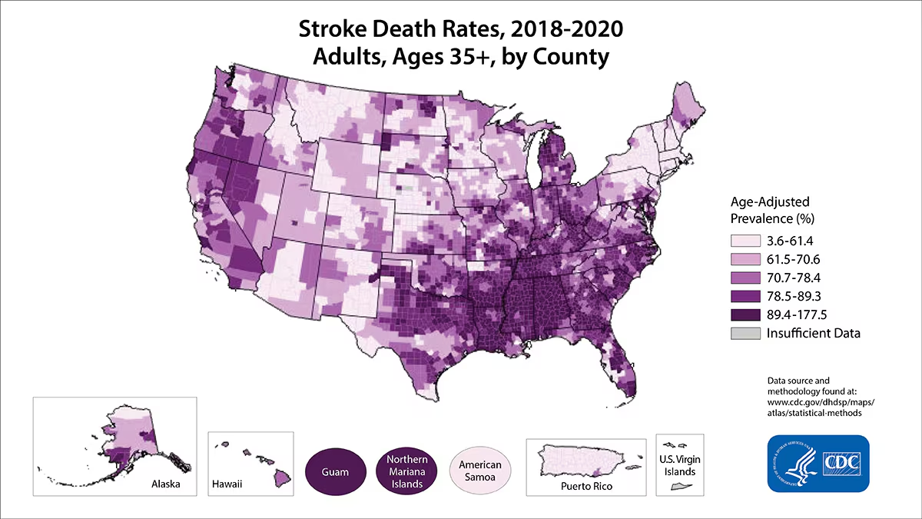
Project Objective
Goal: To develop a predictive model that determines whether or not someone is at risk of getting a stroke using patient health and lifestyle data.
Impact: Enhancing healthcare by enabling early intervention and personalized patient care for strokes.
Notes:
https://www.cdc.gov/stroke/data-research/facts-stats/index.html

Slide 3
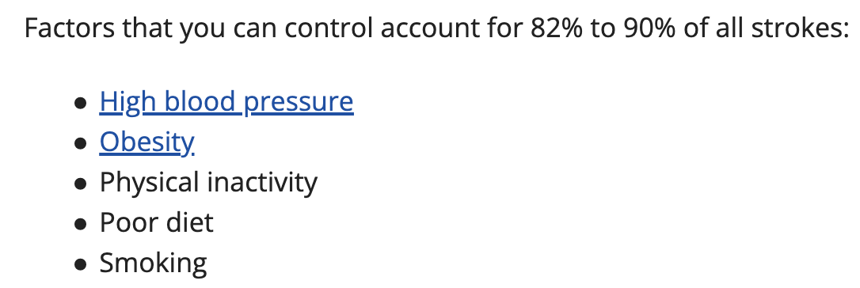
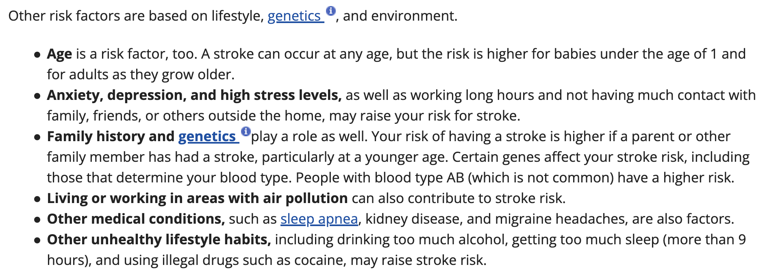
Dataset Overview
Dataset Size:
12,760 instances
27 dimensions.
Some Features:
Patient age
Cholesterol levels (HDL,LDL)
Blood Pressure (Systolic/Diastolic)
Physical Activity (Low, Moderate, High)
Class: Diagnosis (Stroke, No Stroke)
(From https://www.nhlbi.nih.gov/)
Notes:
https://www.nhlbi.nih.gov/health/stroke/causes

Slide 4
Preprocessing
Symptoms Attribute Clean Up
Clean Up Unnecessary Columns
Clean Up Missing Values
Label Encoding
Data Normalization
List of 10 Symptoms (Ex. Blurred Vision), split into 10 binary attributes. Removed missings.
Patient name, Patient ID, Record date, “Cholesterol_levels”, “Blood_Pressure_Levels”
Remove empty blood pressure data. ReplaceMissingValues filter (mean & mode). MathExpression filter + floor function
Convert non-binary nominal attributes to numeric (Ex. Keto Diet to 1). LabelEncoder method Sklearn
Ranges from 0-1 to 100-200. Normalized using Normalize filter on 0-1 scale. Rounded to thousandths using pandas.
1
2
3
4
5

Slide 5
Methods of Attribute Selection
OneR
Simple, but effective, OneR builds a set of rules for each attribute to predict the class variable (Diagnosis), then selected the single set of rules that yields the lowest error rate.
CorrelationAttributeEval
Measures the Pearson correlation between each numeric attribute and the class variable. Attributes with high correlation scores are prioritized, helping identify the most relevant features for the model.

Slide 6
Methods of Attribute Selection cont.
PrincipalComponents (PCA)
A technique that transforms a set of possible correlated variables into principal components consisting of various ratios of the original features. These component vectors are used as new attributes, and they are ranked by how much variance in the dataset each one captures.
ReliefF
Determine how relevant attributes are by comparing how well an attribute can distinguish two similar (nearby) instances. It does this by sampling instances and checking if nearby instances of different classes have similar values for the attribute, therefore identifying features that are useful for class separation.

Slide 7
Methods of Attribute Selection cont.
Personal Selection
Removed patient gender, dietary habits, work type of patients, metabolic equivalent of task score, marital status, alcohol intake, residence type, and all Symptoms (“Blurred Vision,” “Seizures,” “Difficulty Speaking,” “Weakness,” “Confusion,” “Headache,” “Dizziness,” “Severe Fatigue,” “Loss of Balance,” and “Numbness”)

Slide 8
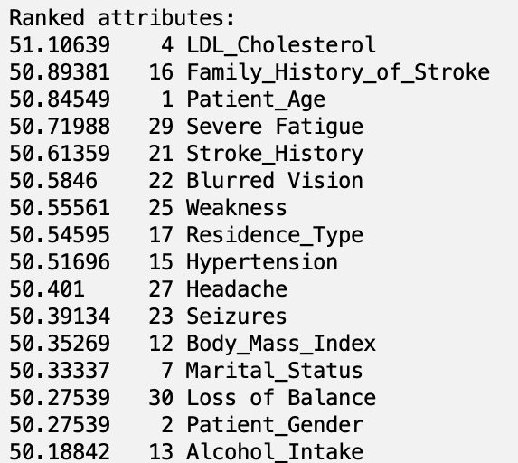
OneR Attribute Selection
Chosen Cut-Off Value: 50.55
Remaining Attributes:
LDL_Cholesterol, Family_History_of_Stroke, Patient_Age, Severe Fatigue, Stroke_History, Blurred Vision, and Weakness

Slide 9
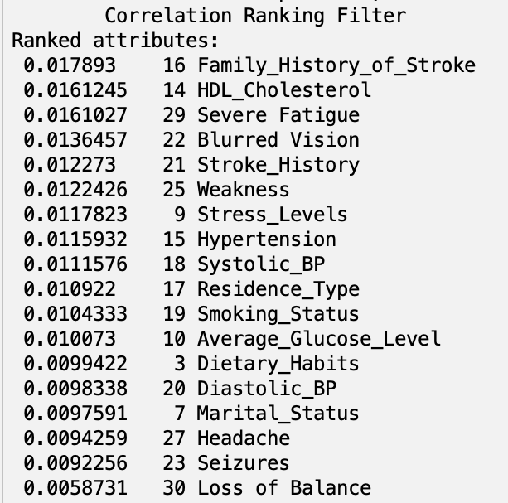
CorrelationAtributeEval Attribute Selection
Chosen Cut-Off Value: 0.01
Remaining Attributes:
Average_Glucose_Level, Smoking_Status, Residence_Type, Systolic_BP, Hypertension, Stress_Levels, Weakness, Stroke_History, Blurred Vision, Severe Fatigue, HDL_Cholesterol, Family_History_of_Stroke

Slide 10
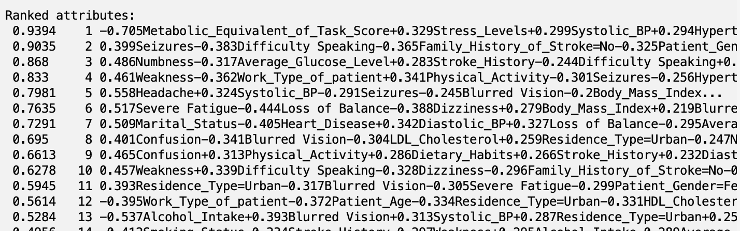
Principal Components Attribute Selection
Chosen Cut-Off Value: 0.8 (80% variance captured)
Remaining Attributes: First 4 Principal Component Vectors used as attributes

Slide 11
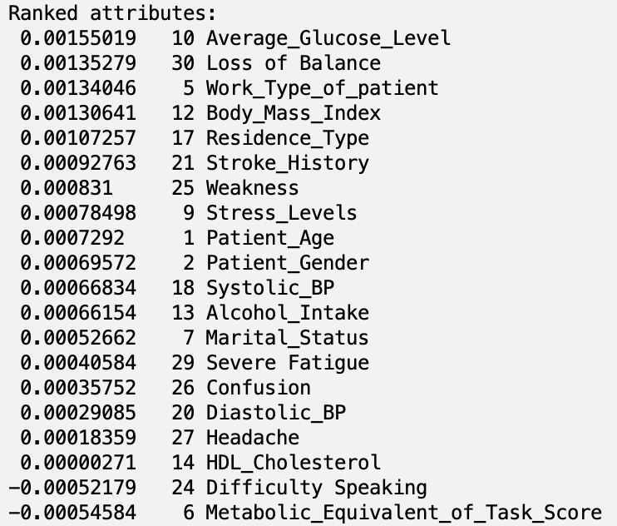
ReliefF Attribute Selection
Chosen Cut-Off Value: 0.001
Remaining Attributes:
Residence_Type, Body_Mass_Index, Work_Type_of_patient, Loss of Balance, Average_Glucose_Level

Slide 12
Classification Models
RandomForest
Classifier that builds multiple decision trees during training and outputs the class that is predicted by majority of the individual trees.
J48
Decision tree algorithm that classifies data by identifying the most informative data from the training set. It can handle missing data and prunes the trees to avoid overfitting, ensuring the model remains applicable to new data.

Slide 13
Classification Models cont.
NaiveBayes
A probabilistic classifier based on Bayes’ theorem with the assumption of independence between features. Naive Bayes is particularly suited for large datasets and datasets where the assumption holds up reasonably well.
Decision Table
Compiles data into a table format, similar to a simplified rule-based symptoms, and makes predictions based on matching cases. Model is very simply to understand, just follow the table.

Slide 14
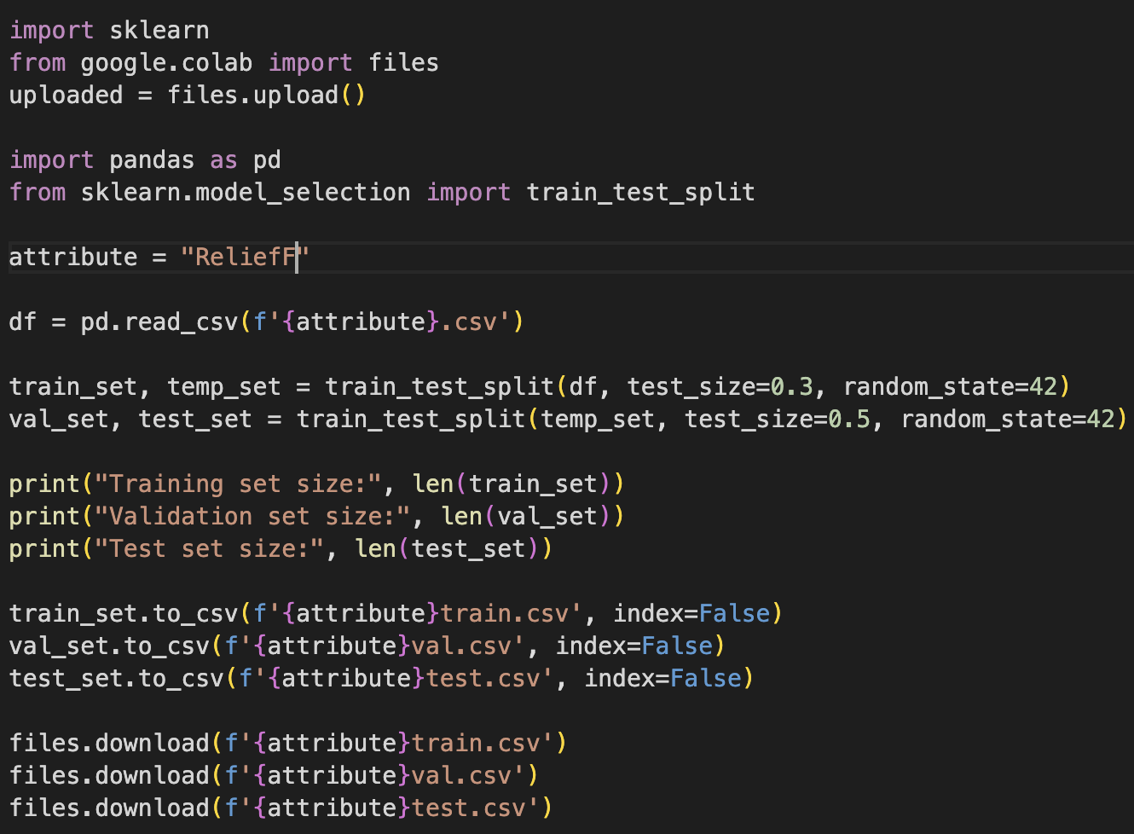
Train/Test/Validation Split
Performed after Attribute selection.
Created 5 different datasets
Split into 70%/15%/15%
7244 train instances, 1553 test instances, 1552 validation instances

Slide 15
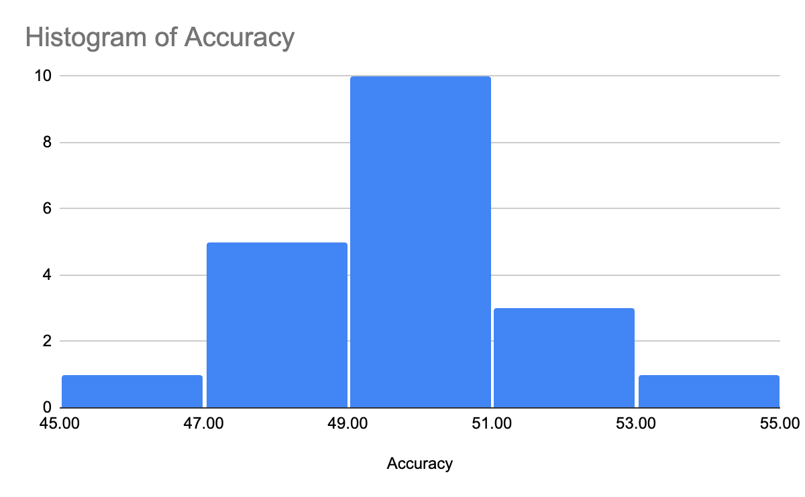
Results
1. CorrelationAttributeEval with RandomForest – 53.51%, 0.535, 0.461, 0.522
2. CorrelationAttributeEval with J48 – 51.45%, 0.514, 0.480, 0.515
3. CorrelationAttributeEval with NaiveBayes – 51.26%, 0.513, 0.474, 0.530
4. Personal Selection with NaiveBayes – 51.10%, 0.511, 0.478, 0.508
5. Personal Selection with RandomForest – 50.87%, 0.509, 0.488, 0.506

Slide 16
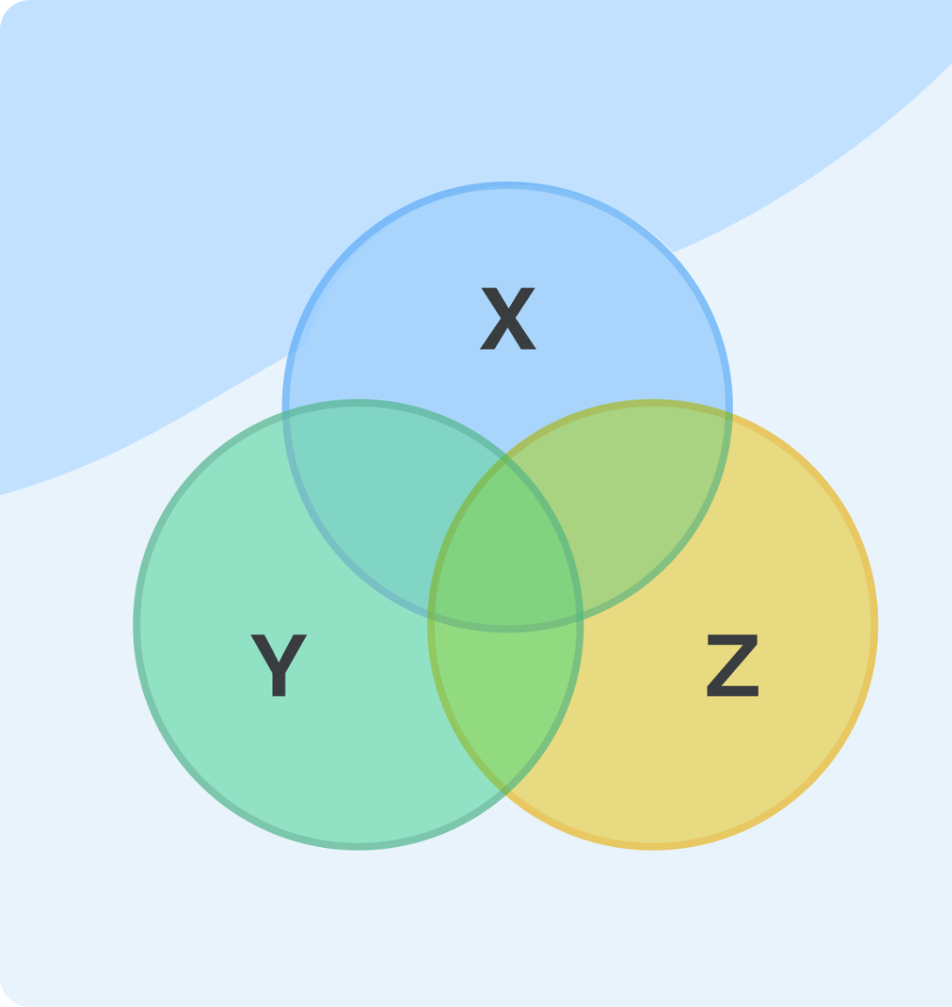
Results Continued
Poor results due to complexity of problem
Subjective attributes are self-reported
Stress Level, Physical Activity
2. Symptoms attributes created overlapping patterns
3. Multicollinearity – attributes are correlated in different combinations. - Overfitting vs Losing valuable data

Slide 17
Conclusion and Future Work
CorrelationAttributeEval with RandomForest classifier most successful
Datasets void of largely subjective data
Find methods to deal with multicollinearity

